Slide 1

Unit 8.1 - Database Concepts
Prepared by: Koh Kian Hua

Slide 2
Objectives
After completing this unit, students should be able to:
Show understanding of the limitations of using a filebased approach for the storage and retrieval of data.
Describe the features of a relational database that address the limitations of a file-based approach.
Show understanding of and use the terminology associated with a relational database model including entity, table, record, field, tuple, attribute, primary key, candidate key, secondary key, foreign key, relationship (one-to-many, one-to-one, many-tomany), referential integrity, indexing.
Use an entity-relationship (E-R) diagram to document a database design.
Show understanding of the normalisation process including First Normal Form(1NF), Second Normal Form (2NF) and Third Normal Form (3NF).
Explain why a given set of database tables are, or are not, in 3NF
Produce a normalised database design for a description of a database, a given set of data, or a given set of tables.
Show understanding of the features provided by a Database Management System (DBMS) that address the issues of a file based approach.
Show understanding of how software tools found within a DBMS are used in practice including the purpose and use of developer interface and query processor.

Slide 3
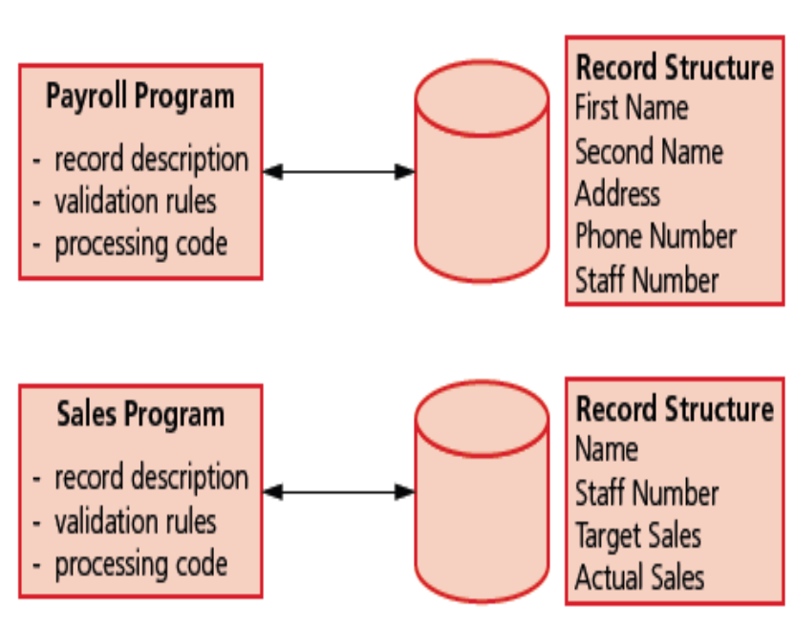
Database Concepts
File-Based Approach
Figure of file-based approach
Problems of file-based approach
The name of a member of staff and their staff number are stored twice.
The way the staff name is stored is different for each program.
If the staff number was changed by the payroll program and not by the sales program, these fields may contain different values for the same member of staff.
The fields in the two files are also in a different order: the staff number is the fifth field in the payroll record and the second field in the sales file.

Slide 4
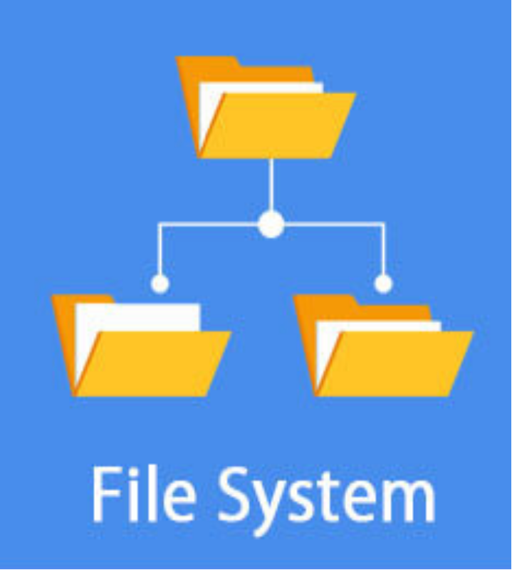
Database Concepts
Limitations of File-Based Approach
A file-based approach is limited because:
Storage space is wasted when data items are duplicated by the separate applications and some data is redundant.
Data can be altered by one application and not by another; it then becomes inconsistent.
Enquiries available can depend on the structure of the data and the software used so the data is not independent.

Slide 5
Database Concepts
Databases & Relational Databases
Database: a structured collection of items of data that can be accessed by different applications programs.
  Data stored in databases is structured as a collection of records.
  Each record is made up of fields containing data about the same ‘item’.
Relational database (RDB): a way of structuring information in tables, rows, and columns.
  A RDB has the ability to establish links - or relationships–between information by joining tables.
  This makes it easy to understand and gain insights about the relationship between various data points.

Slide 6
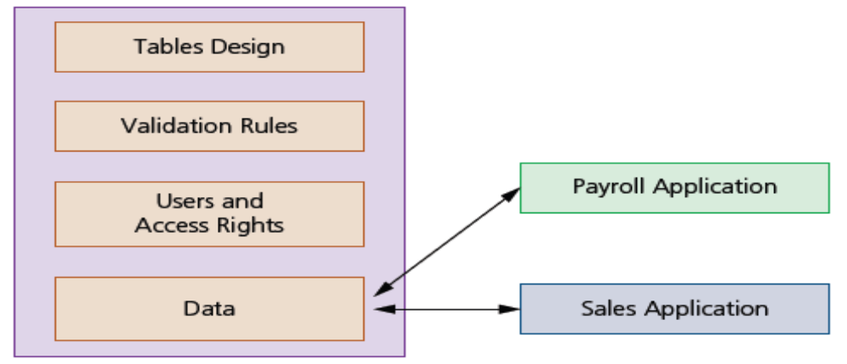
Database Concepts
Benefits of Database Approach
A database approach is beneficial because:
Storage space is not wasted as data items are only stored once, meaning little or no redundant data
Data altered in one application is available in another application, so the data is consistent
Enquiries available are not dependent on the structure of the data and the software used, so the data is independent.

Slide 7
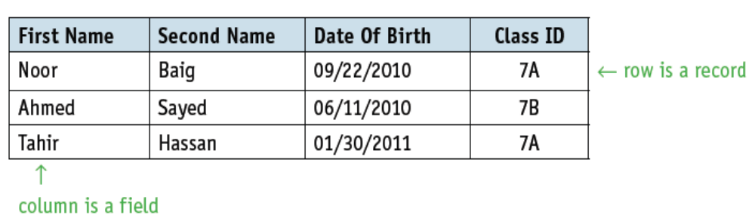
Database Concepts
Relational Database Terminology
A relational database data structure is similar to a file-based structure and consists of records and fields.
  A table: is a group of similar data, in a database, with rows for each instance of an entity and columns for each attribute.
  A record: is a row in a table in a database.
  A field: is a column in a table in a database.
Part of a Student Table:

Slide 8
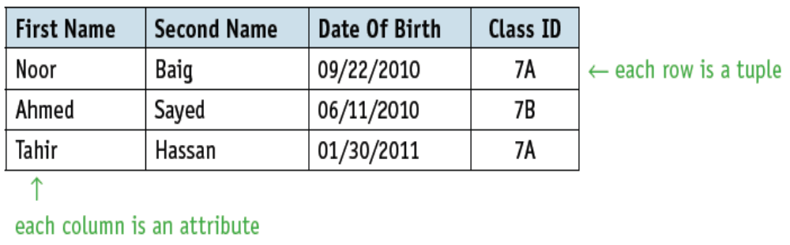
Database Concepts
Relational Database Terminology
There are a few more rigorous terminology used specifically for relational databases.
  A tuple: a logical record or a row of a table.
  An attribute: each column of a table and also refered to as a field.
  An entity: anything that can have data stored about it, such as a person, place, event or object.
Part of a Table for Student Entity:

Slide 9
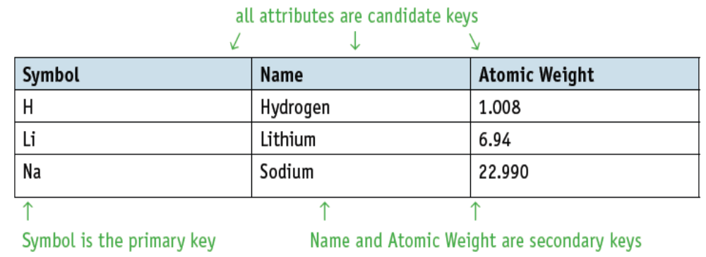
Database Concepts
Relational Database Terminology
Table below shows a list of chemical elements with attributes Symbol, Name and Atomic Weight.
As all these attributes are unique to each element, all are candidate keys.
One of these could be chosen as the primary key, eg: Symbol.
The other two attributes, Name and Atomic Weight, can be secondary keys.

Slide 10
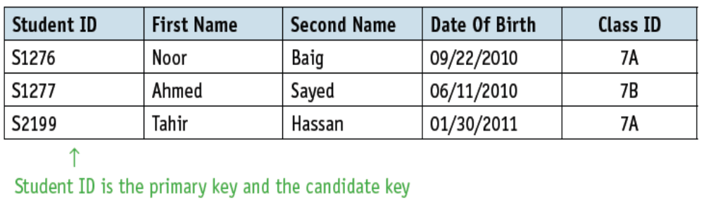
Database Concepts
Relational Database Terminology
Most of the time, tables in a database only one candidate key, which is used as the primary key.
For example, the student table could have an extra attribute Student ID, which is unique to each student.

Slide 11
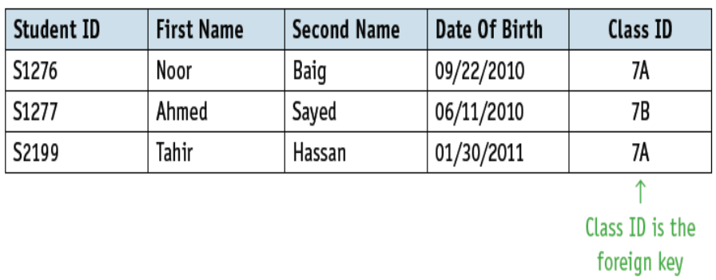
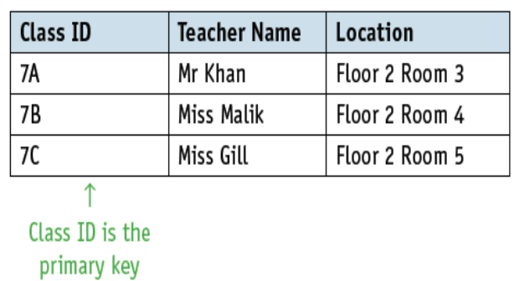
Database Concepts
Relationships
A relationship is formed when one table in a database has a foreign key that refers to a primary key in another table in the database.
In order to ensure referential integrity the database must not contain any values of a foreign key that are not matched to the corresponding primary key.
Example
A school database could contain the table Student and another table Class that contains the Class ID, the Teacher Name and Location of classroom.
Only values for Class ID that are stored in the Class table can be used as the foreign key in the Student table.

Slide 12




Database Concepts
Relationships
Relationships can take several forms:
one-to-one, 1:1 (eg: a person has only one passport and a passport is given to one person.)
one-to-many, 1:m (eg: a customer can place many orders but a order cannot be placed by many customers)
many-to-one, m:1 (eg: many students can study in a single college but a student cannot study in many colleges at the same time)
many-to-many, m:m (eg: a student can be assigned to many projects and a project can be assigned to many students.)

Slide 13
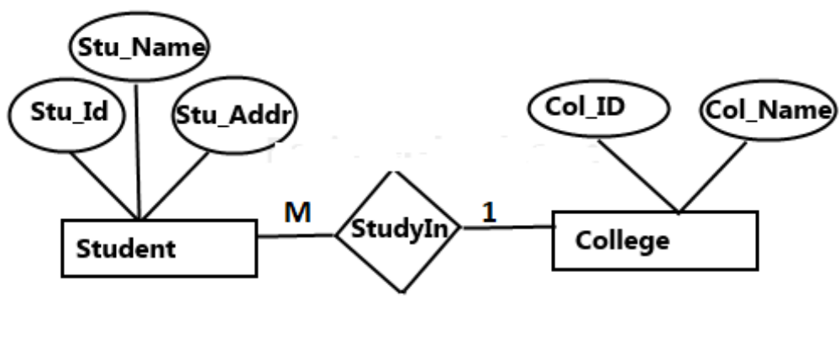
Database Concepts
Entity Relationship (ER) Diagram
An entity relationship diagram (ERD), also known as an entity relationship model, is a graphical representation that depicts relationships among people, objects, places, concepts or events within an information technology (IT) system.
In the following ER diagram we have two entities Student and College and these two entities have many to one relationship as many students study in a single college.

Slide 14
Database Concepts
Database Normalization
An Normalization is a database design technique that reduces data redundancy and eliminates undesirable characteristics.
Normalization rules divides larger tables into smaller tables and links them using relationships.
The purpose of Normalisation in SQL is to eliminate redundant (repetitive) data and ensure data is stored logically.
Tables that are not normalised will be larger. As more data is stored, it will be harder to update the database when changes are made and more difficult to extract the required data to answer queries.

Slide 15
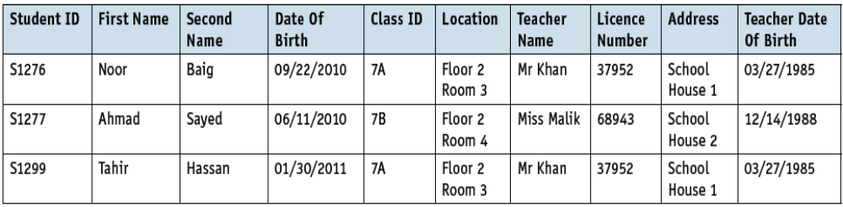
Database Concepts
Database Normalization (Example)
The School database might contain a table shown above (that is un-normalized)
This could cause problems when changes are made to the records.
Every time a new student is added, the teacher’s name, address, licence number, date of birth, and the location of the classroom need to be added as well.
If Mr Khan leaves the school and is replaced by another teacher, then every record containing his name and other details needs to be changed.
If all the students from Class 7B leave, then all the details about Class 7B will be lost.

Slide 16
Database Concepts
Rules for Database Normalization
The rules for normalisation are set out as follows:
First normal form (1NF) – entities do not contain repeated groups of attributes.
Second normal form (2NF) – entities are in 1NF and any non-key attributes depend upon the primary key. There are no partial dependencies.
Third normal form (3NF) – entities are in 2NF and all non-key attributes are independent. The table contains no non-key dependencies.

Slide 17
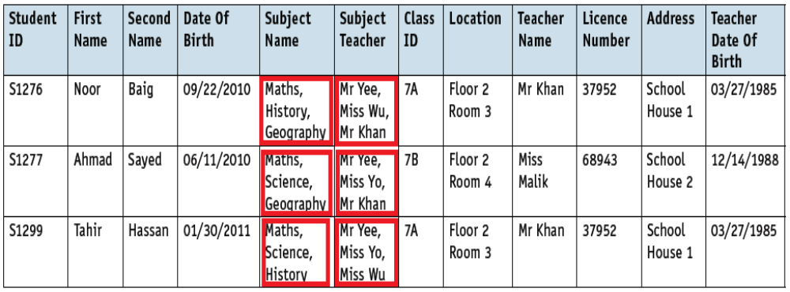
Database Concepts
Un-normalized Form
Un-normalized form: the subject name and subject teacher are the repeating attributes. For the database to be in first normal form, these need to be removed to a separate table and linked to the original table with a foreign key.

Slide 18
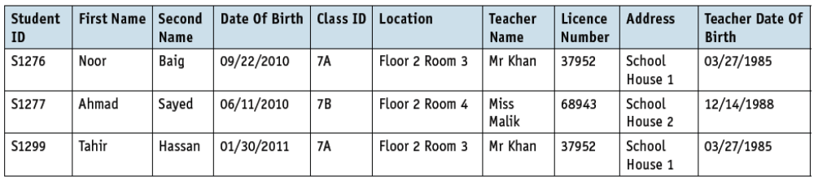
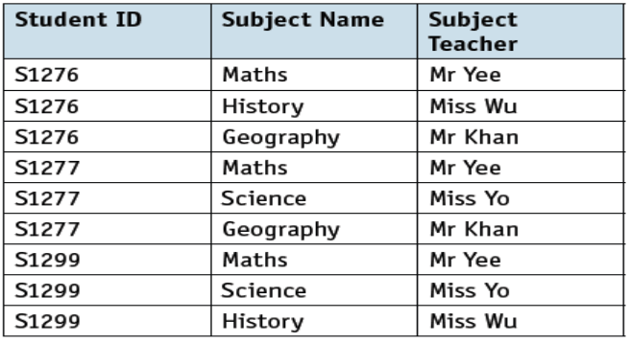
Database Concepts
First Normalized Form (1NF)
The School database can now be represented in 1NF as follows.
STUDENT(StudentID, FirstName, SecondName, DateOfBirth, ClassID, Location, TeacherName, LicenceNumber, Address, TeacherDateOfBirth).
STUDENTSUBJECT(StudentID, SubjectName, SubjectTeacher).
Note:
The primary key for the STUDENTSUBJECT table is a composite key formed from the two attributes StudentID and SubjectName;
2. The attribute StudentID is also a foreign key that links to the STUDENT table.

Slide 19
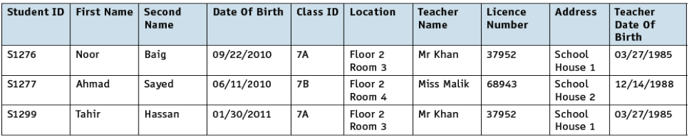
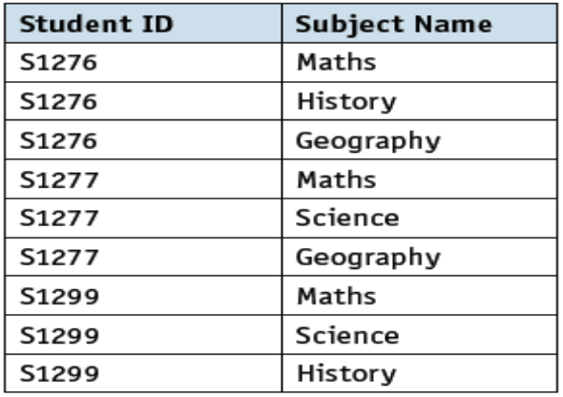
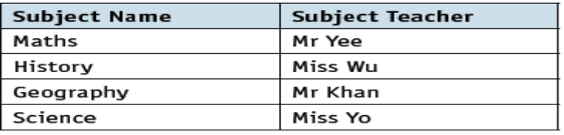
Database Concepts
Second Normalized Form (2NF)
The Second Nornal Form can be represented as follows.
STUDENT(StudentID, FirstName, SecondName, DateOfBirth, ClassID, Location,TeacherName, LicenceNumber, Address, TeacherDateOfBirth)
STUDENTSUBJECT(StudentID, SubjectName).
3. SUBJECT(SubjectName, SubjectTeacher)
Note:
In the STUDENTSUBJECT table, the primary key is a composite key and the SubjectTeacher is only dependent on the SubjectName part of the primary key. This is a partial dependence and needs to be removed by introducing a third table, SUBJECT.

Slide 20
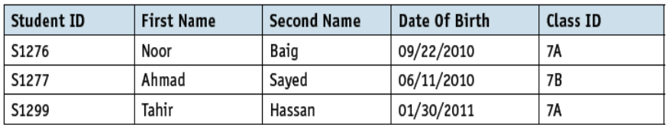
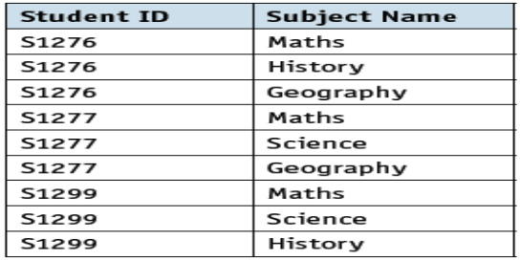
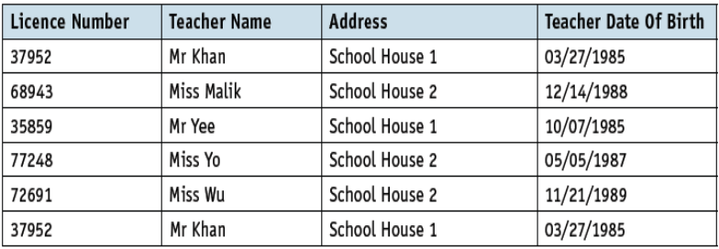
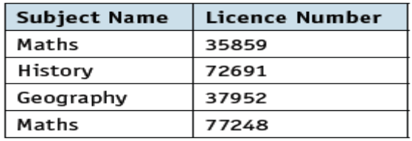
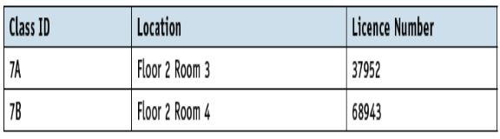
Database Concepts
Third Normalized Form (3NF)
The Third Normal Form can be represented as follows.
1. STUDENT(StudentID, FirstName, SecondName, DateOfBirth, ClassID)
4. STUDENTSUBJECT(StudentID, SubjectName)
2. TEACHER (LicenceNumber, TeacherName, Address, TeacherDateOfBirth)
5. SUBJECT(SubjectName, LicenceNumber)
3. CLASS (ClassID, Location, LicenceNumber)
Note:
From the 2nd Normal Form (2NF) in previous slide, the attributes Location and TeacherName depend upon the attribute ClassID and the attributes LicenceNumber, Address and TeacherDateOfBirth depend upon the attribute TeacherName. These are non-key dependencies that need to be removed to ensure that the database is in 3NF (shown in the current slide)

Slide 21
Database Concepts
Addressing Limitation of File-Based System with DBMS
A Database Management System (DBMS) help to address limitation of a file-based approached via the following:
  Data redundancy issue: solved by storing data in separate linked tables, which reduces the duplication of data as most items of data are only stored once.
  Data inconsistency issue: solved by storing most items of data only once, allowing updated items to be seen by all applications. As data is not inconsistent, the integrity of the data stored is improved.
  Data dependency issue: Data is independent of the applications using the database, and changes made to the structure of the data have little or no effect on the applications using the database.
  Data modelling: a logical schema (data model) that is independent of the DBMS is used to build the database.
  Data security: a DBMS includes data security measures to prevent unwanted corruption, deletion and sharing of data. eg: using usernames, passwords and access rights to prevent authorised access to database, encryption od data stored, automatic creation of activity log to record actions of users.

Slide 22
Database Concepts
DBMS Software Tools
Most of the Database Management System (DBMS) consist of the following software tools:
  Developer Interface: allows a developer to write queries in structured query language (SQL) which are then processed and executed by the query processor. This enables the construction of complex queries to interrogate the database..
  Query Processor: takes a query written in SQL and processes it. The query processor includes a DDL (Data Definition Language) interpreter, a DML (Data Manipulation Language) compiler and a query evaluation

Slide 23
Database Concepts
Class Activity
Describe the limitations of a file-based approach to storage and retrieval of data.
Give two benefits of using a database management system.

